Slide 1

School of Computing Science and Engineering
Course Code: BCS0IT1003 Course Name: Programming for Problem Solving-C
Unit – 2
Control Statements - 3
Program Name: B.Tech

Slide 2
Programming for Problem Solving-C
Recap:-
Control statements:
Decisions(if-else) ✓
Loops (for, while, do-while) ✓
break, continue ✓
case control structure
go to, return
exit statement

Slide 3
Jump Statements – Switch, Case, Break
C has a built-in multiple-branch selection statement, called switch, which successively tests the value of an expression against a list of integer or character constants. When a match is found, the statements associated with that constant are executed.
The default statement is executed if no matches are found. The default is optional, and if it is not present, no action takes place if all matches fail.

Slide 4
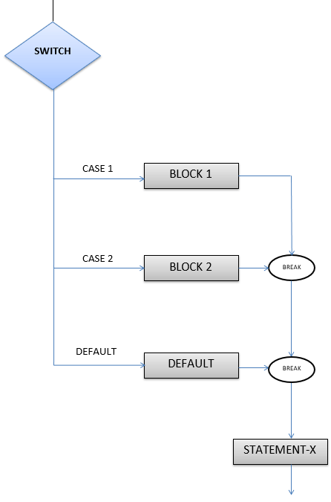
Jump Statements – Switch, Case, Break
switch (expression)
{
case constant1:
statement sequence
break;
case constant2:
statement sequence
break;
case constant3:
statement sequence
break;
.
.
.
default:
statement sequence
}

Slide 5
Jump Statements – Switch, Case, Break
Rules for switch statement:
An expression must always execute to a result.
Case labels must be constants and unique.
Case labels must end with a colon ( : ).
A break keyword must be present in each case.
There can be only one default label.
We can nest multiple switch statements.

Slide 6
Jump Statements – Switch, Case, Break
#include <stdio.h>
int main()
{
int num;
printf("Enter a number : ");
scanf("%d",&num);
switch (num)
{
case 7:
printf("Value is 7");
break;
case 8:
printf("Value is 8");
break;
case 9:
printf("Value is 9");
break;
default:
printf("Out of range");
break;
}
return 0;
}
Output
Enter a number : 8
Value is 8
Enter a number : 6
Out of range

Slide 7
Jump Statements – Switch, Case, Break
Write C program using switch statements that display various arithmetic operations including addition, subtraction, multiplication, and division
case 1:
printf(''Enter two numbers to add'');
scanf(''%d %d'', &x, &y);
z = x + y;
printf(''%d'', z);
break;
case 2:
printf(''Enter two numbers for subtraction'');
scanf(''%d%d'', &x, &y);
z = x - y;
printf(''%d'', z);
break;
case 3:
printf(''Enter two numbers for multiplication'');
scanf(''%d%d'', &x, &y);
z = x * y;
printf(''%d'', z);
break;
#include<stdio.h>
#include<conio.h>
int main()
{
int x, y, z, option;
/* To print the choices available */
printf(''\n 1. Enter 1 to choose addition'');
printf(''\n 2. Enter 2 to choose subtraction'');
printf(''\n 3. Enter 3 to choose multiplication'');
printf(''\n 4. Enter 4 to choose division'');
/* To take an input form the user */
printf(''\n Enter your option'');
scanf(''%d'', &option);
while(option <=4)
{
switch(option)
{

Slide 8
Jump Statements – Switch, Case, Break
case 4:
printf(''Enter two numbers for division'');
scanf(''%d%d'', &x, &y);
z = x / y;
printf(''%d'', z);
break;
default:
printf(''Enter a correct option'');
printf(''press some key to continue'');
}
break;
}
}
Output:
1. Enter 1 to choose addition
2. Enter 2 to choose subtraction
3. Enter 3 to choose multiplication
4. Enter 4 to choose division
Enter your option2
Enter two numbers for subtraction 44 22
22

Slide 9
Jump Statements – Switch, Case, Break
Example program of Fall through statement in switch
#include <stdio.h>
void main()
{
char string[] = "Hello there strange little planet\n";
int x = 0;
while( string[x] )
{
switch( string[x] )
{
case ' ':
case '.':
case ',':
case '!':
case '?':
case ';':
case ':':
case '\n’: putchar('\n');
break;
default: putchar( string[x] );
}
x++;
}
}
Output:
Hello
there
strange
little
planet

Slide 10
Jump Statements – Switch, Case, Break
(Nested Switch)
Nested Switch in C:
In C, we can have an inner switch embedded in an outer switch. Also, the case constants of the inner and outer switch may have common values and without any conflicts.

Slide 11
Jump Statements – Switch, Case, Break
case 2:
printf("Available Departments\n"
printf("1.Department of commerce\n");
printf("2.Department of purchasing\n");
printf("Make your selection.\n");
scanf("%d",&b);
switch(b)
{
case 1:
// code to be executed if b = 1;
printf("You chose Department of commerce\n" );
break;
case 2:
// code to be executed if b = 2;
printf("You chose Department of purchasing" );
break;
}
break;
}
}
Example Program for Nested Switch statement.
#include<stdio.h>
int main()
{
int a,b;
printf("1.School of Computer Science\n");
printf("2.School of Business\n");
printf("3.School of Engineering\n");
printf("make your selection\n");
scanf("%d",&a);
switch (a)
{
case 1:
//code to be executed
//if school of computer science is chosen;
break;

Slide 12
Jump Statements – Switch, Case, Break
Output:
1.School of Computer Science
2.School of Business
3.School of Engineering
make your selection
2
Available Departments
1.Department of commerce
2.Department of purchasing
Make your selection
1
You chose Department of commerce

Slide 13
Jump Statements – Switch, Case, Break
(Nested Switch)
#include <stdio.h>
int main() {
int ID = 500;
int password = 000;
printf("Plese Enter Your ID:\n ");
scanf("%d", & ID);
switch (ID) {
case 500:
printf("Enter your password:\n ");
scanf("%d", & password);
switch (password) {
case 000:
printf("Welcome Dear Programmer\n");
break;
default:
printf("incorrect password");
break;
}
break;
default:
printf("incorrect ID");
break;
}
}
Output:
Plese Enter Your ID:
500
Enter your password:
000
Welcome Dear Programmer
Output:
Plese Enter Your ID:
500
Enter your password:
123
incorrect password
Output:
Plese Enter Your ID:
12345
Incorrect ID

Slide 14
Jump Statements - goto
The goto statement
The goto statement requires a label for operation.
(A label is a valid identifier followed by a colon.)
Furthermore, the label must be in the same function as the goto that uses it— you cannot jump between functions.
The syntax of the goto statement is
goto label;
...
...
label:

Slide 15
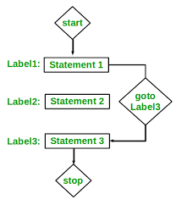
Jump Statements - goto
The goto statement can be used to jump from anywhere to anywhere within a function
Syntax1 Syntax2
---------------------------------
goto label; label:
. .
. .
. .
label: goto label;

Slide 16
Jump Statements - goto
The goto statement (unconditional jump)
Most programmers' chief concern about the goto is its tendency to render programs unreadable.
It is advised that avoid programming that require goto, if used wisely, can be a benefit in a narrow set of programming situations, such as jumping out of a set of deeply nested loops.
Example Code
x = 1;
loop1:
x++;
if(x <= 100) goto loop1;

Slide 17
Jump Statements - goto
Example Code
#include <stdio.h>
int main ()
{
int a = 10;
LOOP:
do
{
if( a == 15)
{
/* skip the iteration */
a = a + 1;
goto LOOP;
}
printf("value of a: %d\n", a);
a++;
}while( a < 20 );
return 0;
}
Output:
value of a: 10
value of a: 11
value of a: 12
value of a: 13
value of a: 14
value of a: 16
value of a: 17
value of a: 18
value of a: 19

Slide 18
Jump Statements - goto
Example Code
#include <stdio.h>
int main()
{
int sum=0;
for(int i = 0; i<=10; i++)
{
sum = sum+i;
if(i==3)
{
goto label1;
}
}
label1:
printf("%d", sum);
return 0;
}

Slide 19
Jump Statements - return
Program with Argument passed but no return value
#include <stdio.h>
void checkPrimeAndDisplay(int n);
int main()
{
int n;
printf("Enter a positive integer: ");
scanf("%d",&n);
// n is passed to the function
checkPrimeAndDisplay(n);
return 0;
}
// return type is void meaning doesn't return any value
void checkPrimeAndDisplay(int n)
{
int i, flag = 0;
for(i=2; i <= n/2; ++i)
{
if(n%i == 0){
flag = 1;
break;
}
}
if(flag == 1)
printf("%d is not a prime number.",n);
else
printf("%d is a prime number.", n);
}
Output:
Enter a positive integer: 7
7 is a prime number

Slide 20
Jump Statements - return
Program with Argument passed and a return value
#include <stdio.h>
int checkPrimeNumber(int n);
int main()
{
int n, flag;
printf("Enter a positive integer: ");
scanf("%d",&n);
// n is passed to the checkPrimeNumber() function
// the returned value is assigned to the flag variable
flag = checkPrimeNumber(n);
if(flag == 1)
printf("%d is not a prime number",n);
else
printf("%d is a prime number",n);
return 0;
}
// int is returned from the function
int checkPrimeNumber(int n)
{
int i;
for(i=2; i <= n/2; ++i)
{
if(n%i == 0)
return 1;
}
return 0;
}
Output:
Enter a positive integer: 7
7 is a prime number

Slide 21
Jump Statements – exit
In C, exit() terminates the calling process without executing the rest code which is after the exit() function.
#include <stdio.h>
#include <stdlib.h>
int main(void)
{
printf("START");
exit(0); // The program is terminated here
printf("End of program"); // This line is not printed
}
Output:
START

Slide 22
Reference
Reference:
‘C’ The Complete Reference - Herbert Schildt
Programming ANSI C, McGraw-Hill – E.Balagurusamy
The C programming language - Brian Kernighan and Dennis Ritchie
Web Reference – www.geeksforgeeks.org

Slide 23
Thank You

